Slide 1
Why is Private Equity Involved with Insurance?

Slide 2
What is Private Equity?
Public Equity: stock market, public firms
Private Equity: everything else
Idea: Private return > Public return? (but also more risk . . . )
  Also much less transparency!
Notes:
Mention regulatory requirements
contrast mutual funds owned by their investors since that’s a same-day topic!

Slide 3
Why Insurance?
Reserves!
  HUGE stock of capital
Private equity can seek higher return b/c different regulation
  + Insurance regulation changes post-GFC
  Two-way street!
Results: top five investment firms own all or part of an insurance company (as of 2023)
More involvement projected (NAIC: Life, P&C, Health . . . everything)
Notes:
Reserves: life insurance companies fund products with large, (theoretically) stable portfolios
Regulation changes: investment grade of bonds -> book value of bonds; allowed for holding riskier debt
NAIC: national association of insurance commissioners – independent body advising regulators

Slide 4
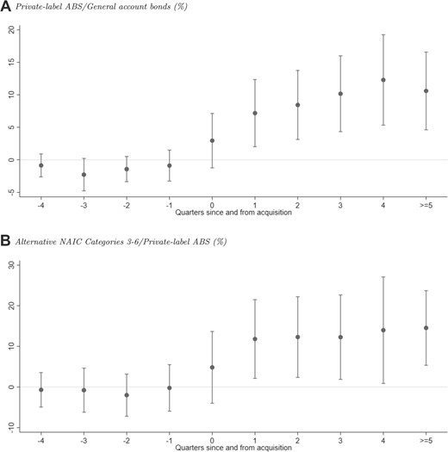
Quarterly Returns, before/after PE Acquisition
(Kirti & Sarin, 2024)

Slide 5
The Tradeoff: Risk vs. Reward
Remember CAPM: higher return = higher risk
Private equity offers higher return . . . but also more risk of failure
  PE invests in lower-grade bonds
  Higher portfolio return => lower prices => more customers?
Does this risk hurt regular people?
  Insurance company funds guaranteed from bankruptcy
    So eventual costs fall on taxpayers (and other insurers)
Increased systemic risk?
Notes:
Companies think this is worth it; regulators aren’t sure
Bankruptcy issue: we don’t want people to pay for an annuity for twenty years and lose it, so the government (+ insurance companies through tax credits) absorb bill. With equity: people can just lose their stock
Systemic risk: all these companies + books interconnected; what happens if there is a large shock?

Slide 6
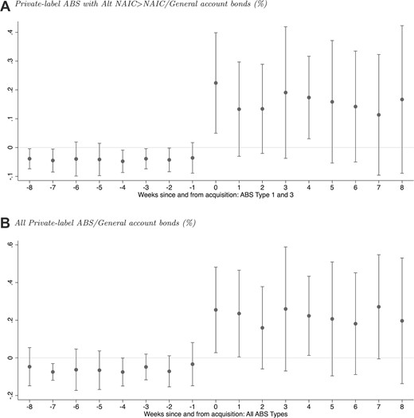
Bond Movements upon Acquisition

Slide 7
Alpha?
Private equity could also seek return above CAPM!
Regulatory arbitrage: private equity can move money more effectively than insurance
  E.g.: move to lower tax locales so after-tax return is greater
  This may not be entirely legal . . .

